Slide 1

Oilseed Grains Outlook:
The Impact of Argentine Crop Losses on Oilseed Markets
May 23, 2018

Slide 2
Argentina experienced an historic drought that reduced soybean production significantly this year.
The impact of the drought may be mitigated by the drawdown of ending stocks, but Argentine farmers have been tight holders in recent years.
The main beneficiary to the losses in Argentina is expected to be Brazil.
The main benefit to the US may be an increase in soybean exports to China and stronger soybean meal exports than expected earlier this year.

Slide 3
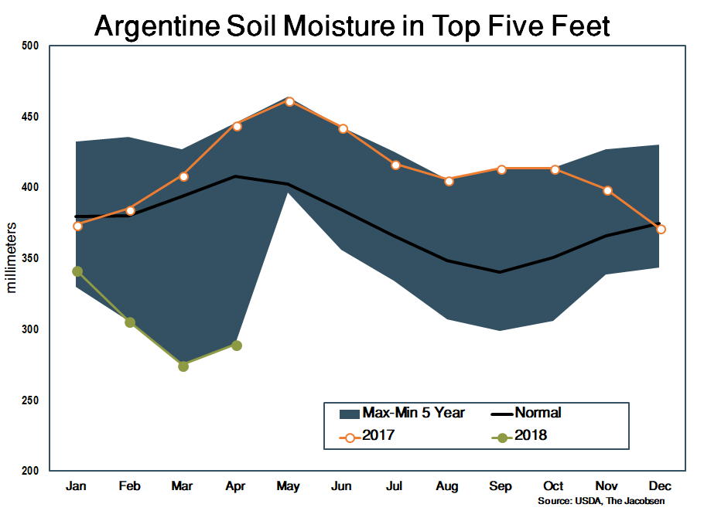
ARGENTINA
Argentina suffered an historic drought during its 2018/19 growing season.
The resulting damage to the soybean crop resulted in significant decreases in production estimates throughout the year.
Ultimately, Argentine production dropped below 40 million tonnes, which is the lowest level since 2009.

Slide 4
ARGENTINA
Argentina is the largest exporter of soybean meal and soybean oil in the world as a result of its export tax structure, which benefits value added products.
Argentina has also held more than 40 percent of the world’s soybean stocks in recent years as farmers stored soybeans as a hedge against inflation.

Slide 5
ARGENTINA
The question of whether Argentine farmers will liquidate soybean stocks to make up for the shortfall in production will be the key in understanding the impact of the drought on world markets.
USDA estimates stocks will decline to just over 12 million tonnes after peaking at almost 20 million last year.
The Jacobsen also believes stocks will decline, but do not think the decline will be as dramatic.

Slide 6
ARGENTINA

Slide 7
ARGENTINA
After the impact to stocks, the impact to the soybean crush is the second largest fundamental impact of the drought.
USDA increases the crush slightly, but uses the small increase in production to increase domestic feed usage while decreasing exports.
The Jacobsen reduces crush by more than two million tonnes, resulting in an almost one-million-tonne reduction in meal production, similar reduction in exports and a slightly decline in domestic usage.

Slide 8
ARGENTINA

Slide 9
ARGENTINA
The impact of the drought on the soybean oil balance sheet is smaller than on soybean or meal balance sheets.
USDA reduces production by just 30,000 tonnes, which results in minor reductions in exports, biodiesel production and stocks, which offset a small increase in food usage.
The Jacobsen reduces production by a little less than 500,000 tonnes, which is offset by reductions in exports, biodiesel production, stocks and a small reduction in non-biodiesel usage.

Slide 10
ARGENTINA

Slide 11
BRAZIL
The biggest beneficiary of the relatively limited changes in the Argentine balance sheets is Brazil.
Brazil produced its second straight record soybean crop last year with production up almost 80 percent over the last five years.
The increase in output has been the result of beneficial weather during the growing season, which is reflected, partially, in a 30-percent increase in yield and a 40-percent increase in harvested area.
USDA reduces Brazil’s crush slightly from last year’s estimate, while the Jacobsen raises its forecast from a lower level. Combined, the two projections process roughly the same amount of soybeans over the two years.

Slide 12
BRAZIL

Slide 13
BRAZIL
Despite a slight reduction in its crush forecast, USDA’s projected soybean meal supplies increase due to larger carryin stocks and a reduction in ending stocks. USDA offsets the larger supply with a significant increase in exports and a smaller increase in domestic feed usage.
The Jacobsen also increases exports significantly and slightly more than USDA, as Brazil takes advantage of flat Argentine exports and growth in world soybean meal demand.
Soybean meal supplies also increase in the Jacobsen’s projections and are offset in a similar manner with the increased exports accompanied by a small increase in domestic usage and a small decrease in ending stocks.

Slide 14
BRAZIL

Slide 15
BRAZIL
USDA and The Jacobsen have similar projections for Brazilian soybean oil but get there in slightly different ways.
USDA’s smaller production is offset with an increase in supplies due to larger carryin stocks and smaller ending stocks, which are offset with a small increase in biodiesel production, a larger increase in exports and steady food usage.
The Jacobsen gets most of its larger supply from the larger crush, but offset the increase in supply with increases in domestic usage and exports that are similar to USDA’s projections.

Slide 16
BRAZIL

Slide 17
UNITED STATES
The US crush is forecast to reach a record during the 2017/18 marketing year, but it has not being driven by the drought in Argentina. The record crush has been driven by strong domestic meal demand. However, if domestic demand is not as strong as anticipated, the drought could provide opportunities for growth in soybean meal exports that could continue support crush margins, although probably not at the same levels.

Slide 18
UNITED STATES
US soybean exports could benefit marginally from the drought in Argentina. The Jacobsen is projecting Argentine soybean exports to China will decline by 1.5 million tonnes. The US could increase its shipments to China by close to that amount, particularly now that the concerns about Chinese tariffs have receded. However, Brazil’s record crop will also provide an opportunity for Brazilian shipments to fill some of the gap left by Argentina.
The Jacobsen is currently projecting 2017/18 US soybean exports at two billion bushels, which is well below USDA’s May projection of 2.07 billion.

Slide 19
UNITED STATES

Slide 20
UNITED STATES
The Jacobsen and USDA have similar outlooks for US soybean meal balance sheets with stronger domestic usage and exports offsetting the increased supply from the record crush.

Slide 21
UNITED STATES

Slide 22
UNITED STATES
The Jacobsen and USDA both expect soybean oil exports to decrease from last year as increased usage in biodiesel production crowds makes US exports more expensive. However, The Jacobsen believes US exports will decline more than USDA.
The Jacobsen differs with USDA in minor ways in its soybean oil balance sheets, but the sum of those minor differences (The Jacobsen is projecting smaller biodiesel production, food usage and exports) results in The Jacobsen projecting ending stocks that are significantly above USDA’s projections.

Slide 23
UNITED STATES

